Slide 1
Software Resource Data Reporting (SRDR)

Slide 2
Software Resource Data Reporting (SRDR)
Overview
Resources
Data Item Description (DID):
DI-MGMT-82035
Development, Format 1:
DD Form 3026-1
Maintenance, Format 2:
DD Form 3026-2
Enterprise Resource Planning (ERP):
DD Form 3026-3
Intent of SRDR is to collect objective and measurable data commonly used by industry and DoD cost analysts
Builds a repository of estimated and actual:
  SW product sizes
  Schedules
  Effort
  Quality
Notes:
The reports are not management reports and are not intended for tracking progress

Slide 3
Software Resource Data Reporting (SRDR)
New Formats
Development
Maintenance
ERP
Technical Data
SW size, context, technical information
Release level and computer SW configuration item (CSCI) level sections
Technical Data
SW size, context, technical information
Top level and release level sections
Technical Data
Provides context, SW product, Development Team, etc.
Part 1
Effort Data
Reports SW efforts associated with each reported release and CSCI
Effort Data
Reports the to-date SW maintenance efforts for each in-progress and completed release(s), and total maintenance activities
Effort Data
Project resource and schedule information at the release level
Part 2
Notes:
Development
CSCI is the lowest level of software development at which configuration management is performed by the developer. usually indicated by a separate Software Development Folder (SDF), Software Requirements Specification (SRS) etc. The CSDR plan will serve as the authoritative definition for reporting purposes
Maintenance
The Top Level Data includes all information applicable to the software maintenance release(s) for the reporting event, defines each of the data elements as required, and describes the methods and rules used to perform the data measurement or estimation. The Release Level Data is used to obtain the actual (as-built) characteristics of the maintenance product and its maintenance process at the Release level.
ERP
Part 1, System Technical Data, provides the report context, describes both the software product being developed and the development team, lists project requirements for modules, business processes, system functions and interfaces, and captures software product size and complexity at the Release Level. Part 2, Software Development Effort Data, captures project resource and schedule information at the Release Level. Format 3 uses the term “release” to refer to commonly used terms such as build, product build, and increment, but this document will use release as the primary term throughout.

Slide 4
Software Resource Data Reporting (SRDR)
Updates
Development
Maintenance
Format 1 Updates
Introduction of Agile Measures
Supports capturing the LOE with this SW dev methodology
Instructions captured within DID
Format 2 Updates
Clarified SW change count definitions
Confusion in original DID regarding inclusion of Information Assurance Vulnerability Alerts (IAVAs)
Updated instructions to ensure IAVA changes are mutually exclusive from Priority 1-5 changes, and are not double counted
Moved SW License Management Hours reporting to Project Management (PM)
SW License Management is a PM activity
No Additional Significant Updates to Format 1 and 2
Notes:
Format 2
The Top Level Data includes all information applicable to the software maintenance release(s) for the reporting event, defines each of the data elements as required, and describes the methods and rules used to perform the data measurement or estimation. The Release Level Data is used to obtain the actual (as-built) characteristics of the maintenance product and its maintenance process at the Release level.

Slide 5
Software Resource Data Reporting (SRDR)
Submission Event Process Flow Diagram

Slide 6
Software Resource Data Reporting (SRDR)
Presented by:
Paul Kopicki, paul.a.kopicki.civ@mail.mil

Slide 7
Software Resource Data Report (SRDR)
AGENDA
Software DID Overview (Development/Maintenance/ERP)
Software Data DID CRM Review
Software Data DID Path Forward

Slide 8
Software DID Overview (Development/Maintenance/ERP)

Slide 9
Software DID Overview (Development/Maintenance/ERP)
Software DID Overview
Software Resources Data Reporting:
  Data Item Description: DI-MGMT-82035
  Development, Format 1: DD Form 3026-1
  Maintenance Report, Format 2: DD Form 3026-2
  Enterprise Resource Planning (ERP), Format 3: DD Form 3026-3

Slide 10
Software DID Overview (Development/Maintenance/ERP)
Data Item Description (DID): DI-MGMT-82035
DID summarizes the Software (SW) Development Report, Maintenance Report, and ERP SW Development Report
Provides instructions to support data and Frequency requirements specified in the CSDR reporting
Intent of SRDR is to collect objective, measurable data commonly used by industry and DoD cost analysts
Builds a repository of estimated and actual:
    SW product sizes
    Schedules
    Effort
    Quality
Notes:
The reports are not management reports and are not intended for tracking progress

Slide 11
Software DID Overview (Development/Maintenance/ERP)
Development, Format 1: DD Form 3026-1
Consists of two parts
Part 1 – SW Development Technical Data
  SW size, context, technical information
  Release Level and Computer SW Configuration Item (CSCI) Level sections
Part 2 – SW Development Effort Data
  Reports SW efforts associated with each reported release and CSCI
Notes:
CSCI is the lowest level of software development at which configuration management is performed by the developer. usually indicated by a separate Software Development Folder (SDF), Software Requirements Specification (SRS) etc. The CSDR plan will serve as the authoritative definition for reporting purposes

Slide 12
Software DID Overview (Development/Maintenance/ERP)
Development, Format 1: DD Form 3026-1
Format 1 updates:
Introduction of Agile Measures
Instructions captured within DID
No Additional Significant Updates to Format 1
Notes:
Introducing Agile Measures supports capturing the LOE with this SW dev methodology

Slide 13
Software DID Overview (Development/Maintenance/ERP)
Maintenance Report, Format 2: DD Form 3026-2
Consists of two parts
Part 1 – SW Maintenance Technical Data
  SW size, context, technical information
  Top Level and Release Level sections
Part 2 – SW Maintenance Effort Data
  Reports the to-date SW maintenance efforts for each in-progress and completed release(s), and total maintenance activities
Notes:
The Top Level Data includes all information applicable to the software maintenance release(s) for the reporting event, defines each of the data elements as required, and describes the methods and rules used to perform the data measurement or estimation. The Release Level Data is used to obtain the actual (as-built) characteristics of the maintenance product and its maintenance process at the Release level.

Slide 14
Software DID Overview (Development/Maintenance/ERP)
Maintenance Report, Format 2: DD Form 3026-2
Format 2 updates
  Clarified SW change count definitions
    Confusion in original DID regarding inclusion of Information Assurance Vulnerability Alerts (IAVAs)
    Updated instructions to ensure IAVA changes are mutually exclusive from Priority 1-5 changes, and are not double counted
  Moved SW License Management Hours reporting to Project Management (PM)
    SW License Management is a PM activity
No Additional Significant Updates to Format 1
Notes:
The Top Level Data includes all information applicable to the software maintenance release(s) for the reporting event, defines each of the data elements as required, and describes the methods and rules used to perform the data measurement or estimation. The Release Level Data is used to obtain the actual (as-built) characteristics of the maintenance product and its maintenance process at the Release level.

Slide 15
Software DID Overview (Development/Maintenance/ERP)
Enterprise Resource Planning (ERP), Format 3: DD Form 3026-3
SW Development Report specifically for ERP or Defense Business System programs
  Financial
  Personnel
  Inventory
Consists of two parts
Part 1 – System Technical Data
  Provides context, SW product, Development Team, etc.
Part 2 – SW Development Effort Data
  Project resource and schedule information at the Release Level
Notes:
. Part 1, System Technical Data, provides the report context, describes both the software product being developed and the development team, lists project requirements for modules, business processes, system functions and interfaces, and captures software product size and complexity at the Release Level. Part 2, Software Development Effort Data, captures project resource and schedule information at the Release Level. Format 3 uses the term “release” to refer to commonly used terms such as build, product build, and increment, but this document will use release as the primary term throughout.

Slide 16
Software DID Overview (Development/Maintenance/ERP)
Enterprise Resource Planning (ERP), Format 3: DD Form 3026-3
Part 1 – Technical Data
Notes:
. Similar look and feel to Formats 1 & 2

Slide 17
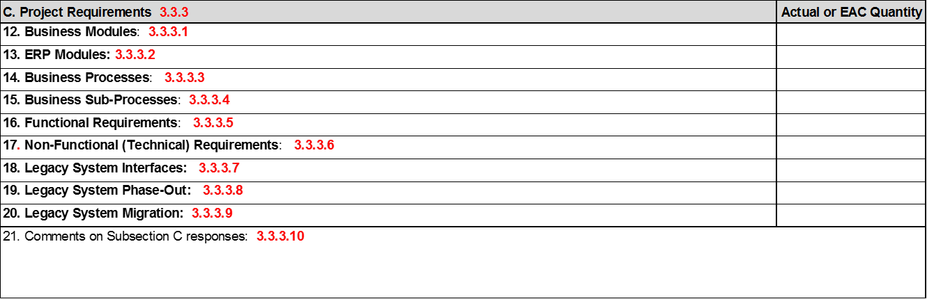
Software DID Overview (Development/Maintenance/ERP)
Enterprise Resource Planning (ERP), Format 3: DD Form 3026-3
Part 1 – Technical Data
Notes:
. Similar look and feel to Formats 1 & 2

Slide 18
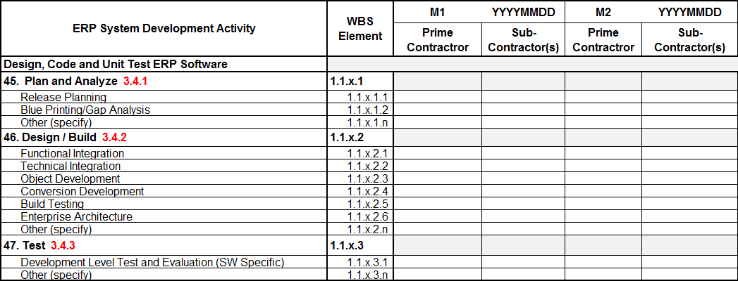
Software DID Overview (Development/Maintenance/ERP)
Enterprise Resource Planning (ERP), Format 3: DD Form 3026-3
Part 2 – SW Development Effort Data
Notes:
. Similar look and feel to Formats 1 & 2

Slide 19
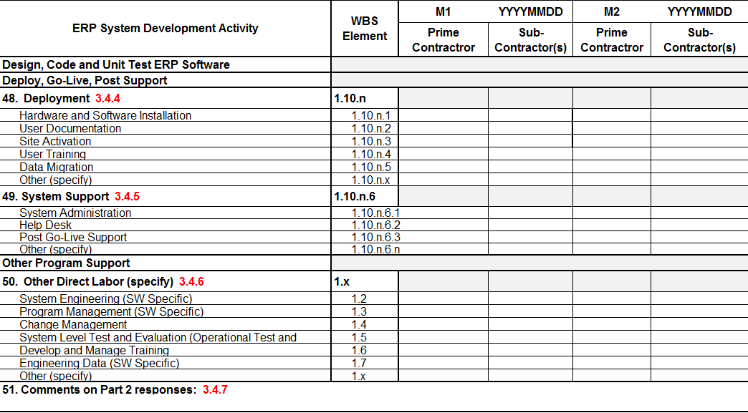
Software DID Overview (Development/Maintenance/ERP)
Enterprise Resource Planning (ERP), Format 3: DD Form 3026-3
Part 2 – SW Development Effort Data
Notes:
. Similar look and feel to Formats 1 & 2

Slide 20
Software DID Overview (Development/Maintenance/ERP)
Enterprise Resource Planning (ERP), Format 3: DD Form 3026-3
Part 2 – SW Development Effort Data
Notes:
. Similar look and feel to Formats 1 & 2

Slide 21
Software Data DID
CRM Review

Slide 22
Software Data DID CRM Review
SRDR DID & Forms CRM Review
Several rounds of comments through Gov. and Industry
Last round of DID and Forms sent in April 17; Reviewed/Adjudicated comments with SRDR WG through early May
  Open comments coordinated with developers and closed out with POCs end of May
37 Comments
18
11
6
Document | # of Comments | Taking Action | No Action
General SRDR DID/Form | 20 | 7 | 13
Maintenance Form | 11 | 7 | 4
ERP Form | 6 | 2 | 4
 | 37 | 16 | 21
2

Slide 23
Software Data DID CRM Review
SRDR DID & Forms CRM Review
37 Comments
Major DID Changes since May 2017
  Agile metrics reporting
    From: All agile programs instructed to use ERP instructions and submit agile data using Format 3
    To: Format 1 was updated to include Agile table too
  New version of Figure 1 to clarify intent
18
11
6
2

Slide 24
Software Data DID
Backup

Slide 25
Software Data DID Backup
Agile Measures
Comment | Proposed Solution
For clarity and consistency, update the Traditional Development Form and DID language to include the Agile Measures section that is currently found within the ERP section of the DID. | Updated the Forms and DID to duplicate the ERP agile measures language and requirement within the Development form. Agile measures is now reflected on both forms and both sections in the DID
For clarify: Cross references from Form 1 to Form 3 were eliminated by moving the Agile Measures section into Form 1
Notes:
.

Slide 26
Software Data DID Backup
Submission Event Process Flow Diagram
Comment | Proposed Solution
Text contradicts the process flow diagram (Figure 1) found within the DID. Provide clarification to update the text and image, so it is in alignment with reporting (initial, interim, final) deliverables and expectations. | Updated Figure 1 and associated text.
Notional submission event diagram and associated text was confusing
To avoid confusion, Figure 1 was updated (next slide)
Notes:
.

Slide 27
Software Data DID Backup
Submission Event Process Flow Diagram
Notes:
.

Slide 28
Software Data DID Backup
DID Comments Summary
Of the 37 comments….
Comments bucketed into 7 categories
Majority of comments were for additional Clarification or Questions
Comments were not received differentiating between critical, substantive, or administrative
37 Comments
Clarification……………………….…………. |  | 18
 | Question………………………………….…… | 10
 | Administrative…………………………..…. | 3
 | Process Diagram…………………………... | 3
 | Duplication Comment…………………… | 1
 | Not Actionable………………….………….. | 1
 | General..…………..……………..…………… | 1

Slide 29
Software Data DID Backup
Development, Format 1: DD Form 3026-1, Initial Report, Common Heading- Faked

Slide 30
Software Data DID Backup
Development, Format 1: DD Form 3026-1, Initial Report, Release Level - Faked

Slide 31
Software Data DID Backup
Development, Format 1: DD Form 3026-1, Initial Report, Release Level - Faked

Slide 32
Software Data DID Backup
Development, Format 1: DD Form 3026-1, Initial Report, CSCI Level - Faked

Slide 33
Software Data DID Backup
Development, Format 1: DD Form 3026-1, Initial Report CSCI Level - Faked

Slide 34
Software Data DID Backup
Development, Format 1: DD Form 3026-1, Initial Report CSCI Level - Faked

Slide 35
Software Data DID Backup
Maintenance Report, Format 2: DD Form 3026-2, Initial Report Common Heading - Faked

Slide 36
Software Data DID Backup
Maintenance Report, Format 2: DD Form 3026-2, Initial Report Part 1 - Faked

Slide 37
SURF Process Summary & Initial Findings:
A Deeper Focus on Software Data Quality
This document was generated as a result of the AFCAA-led, Software Resource Data Report Working Group (SRDRWG). This working group represented a joint effort amongst all DoD service cost agencies. The following guidance describes SRDR data verification and validation best practices as documented by NCCA, NAVAIR 4.2, AFCAA, ODASA-CE, MDA, and many more.
Presented by:
Ranae Woods, AFCAA, ranae.p.woods.civ@mail.mil
Dan Strickland, MDA , daniel.strickland@mda.mil
Nicholas Lanham, NCCA, nicholas.lanham@navy.mil
Marc Russo, NCCA, marc.russo1@navy.mil
Haset Gebre-Mariam, NCCA, haset.gebremariam@navy.mil

Slide 38
SURF Process Summary & Initial Findings
Table of Contents
  Purpose
  SRDR Need Statement
  SURF Purpose
  SURF Created Process Initiation
  SURF Team Structure
  SURF Verification & Validation (V&V) Guide
  SRDR V&V Process
  SRDR Database
  SRDR Data Quality Review
  SURF Status and Metrics
  Summary

Slide 39
SURF Process Summary & Initial Findings
Presentation Purpose
  To familiarize the audience with recent Software Resource Data Report (SRDR) Working Group (WG) efforts to update existing SRDR DID language and implement data quality improvement
  To clarify how these SRDRWG efforts led to the development of a SRDR Unified Review Function (SURF) team
  To highlight:
    SURF mission
    Highlight SURF team and Verification and Validation (V&V) guide positive impact on SRDR data quality

Slide 40
SURF Process Summary & Initial Findings
SURF Need Statement
  Why do these reports need to be reviewed?
  Reduces inaccurate use of historical software data
  Aligns with OSD CAPE initiative(s) to improve data quality
  Helps correct quality concerns prior to final SRDR acceptance
  Allows a central group of software V&V SMEs to tag SRDR data
  SRDR submissions are used by all DoD cost agencies when developing or assessing cost estimates
  Quality data underpins quality cost and schedule estimates
  BBP Principle 2: Data should drive policy. Outside my door a sign is posted that reads, "In God We Trust; All Others Must Bring Data." The quote is attributed to W. Edwards Deming
  - Mr. Frank Kendall, AT&L Magazine Article, January-February 2016

Slide 41
SURF Process Summary & Initial Findings
SURF Purpose
Purpose
  To supplement the Defense Cost Resource Center (DCARC) quality review for SRDR submissions
  To develop a consistent, service-wide set of quality questions for all DoD cost community members to reference
  To provide a consistent, structured list of questions, focus areas, and possible solutions to cost community members tasked with inspecting SRDR data submissions for completeness, consistency, quality, and usability (e.g. SRDR V&V Guide)
Why?
  SURF represents an effort to establish a consistent guide for any organization assessing the realism, quality, and usability of SRDR data submissions
  Quality data underpins quality cost and schedule estimates
  Question: What services helped develop the questions included within the latest SRDR V&V guide?
  Answer: All services participating in the SRDR WG provided feedback, comments, and reviews over a year long SRDRWG effort focused on establishing higher quality review efforts coupled with an ongoing SRDR DID update

Slide 42
SURF Process Summary & Initial Findings
How Was SURF Created?
Recommendation
Benefit
Revised SRDR Development Data Item Description (DID)
New SRDR Maintenance Data Item Description (DID)
Joint Validation & Verification (V&V) Guide, Team, and Process
Software Database Initial Design and Implementation Process
Reduces inconsistency, lack of visibility, complexity, and subjectivity in reporting
Aligned w/ dev. but w/ unique data/metrics available/desired for maintenance phase
Higher quality, less duplication - ONE central vs many distributed; 1 joint team & guide gives early, consistent feedback to ktrs
Avoids duplication, variations - ONE central vs many distributed; Based on surveyed best practices and user expectations
  Question: How was the SURF team created and is it linked to the SRDRWG?
  Answer: Yes. The SRDR Unified Review Function (SURF) team was organized as part of the larger, SRDRWG initiative during 2015

Slide 43

SURF Process Summary & Initial Findings
SURF Team Structure
  Team is comprised of one primary member per service along with support from secondary team members (Government Only)
  As submissions are received, SRDR review efforts will be distributed amongst SURF team members to balance workload
  SURF Team Coordinators (STC): Marc Russo & Haset Gebre-Mariam
  Current SURF structure:
DCARC Analyst & STC:
SURF Team Coordinators (STC)
Marc Russo
Haset Gebre-Mariam
SRDR Submission received from DCARC
SURF Advisor & Process Owner (SAPO)
Nick Lanham
SURF Primary:
DoD
William Raines
Navy
Corrinne Wallshein
Wilson Rosa
Marine Corps
Noel Bishop
Air Force
Ron Cipressi
Army
Jim Judy
Jenna Meyers
James Doswell
SPAWAR
Jeremiah Hayden
MDA
Dan Strickland
SURF Secondary:
Stephen Palmer
Philip Draheim
Sarah Lloyd
John Bryant
Janet Wentworth
Chinson Yew
Eric Sommer
Michael Smith
Michael Duarte
Min-Jung Gantt
Question: How do members get involved with SURF? Why are there “primary” and “secondary” members?
Answer 1: The SURF team was established by Government SRDRWG members who were recommended/volunteered by each DoD service
Answer 2: Primary members are included on CSDR S-R IPT email notifications for their specific service. Secondary members are contacted during periods of increased review demands, if necessary.

Slide 44
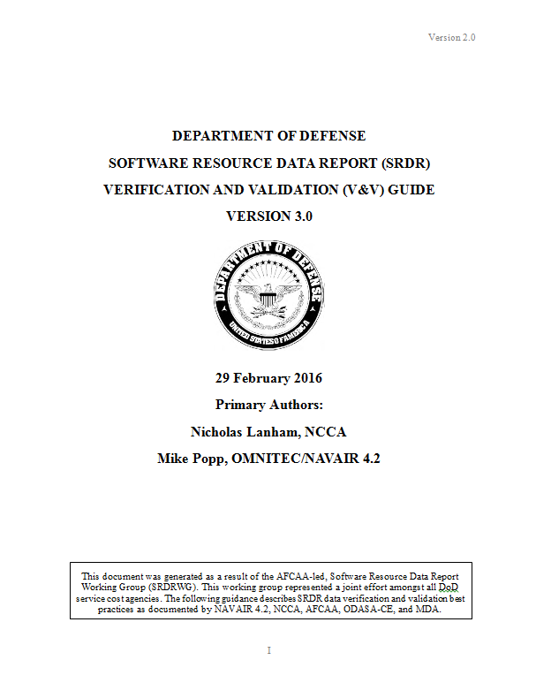
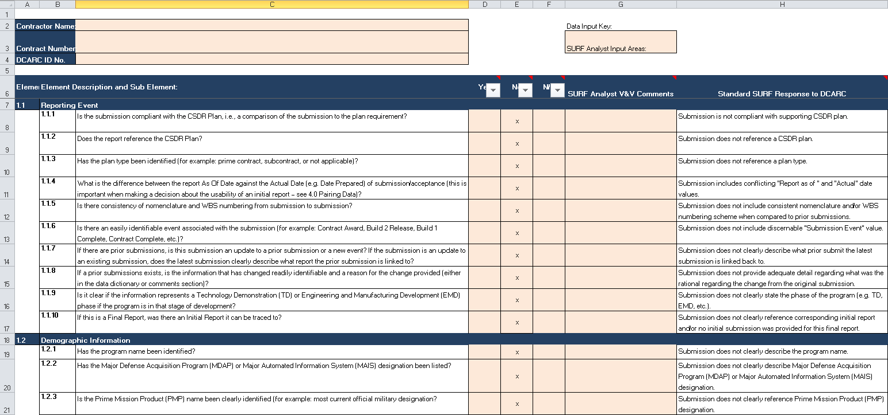
SURF Process Summary & Initial Findings
SRDR V&V Guide
Guide represents first-ever, joint effort amongst DoD service cost agencies
  OSD public release approved 5 April 2016
  Kickoff email distributed on 1 May 2017 to update guide with latest DID requirements
  Files can be downloaded using following link: http://cade.osd.mil/roles/reviewers#surf
Enables ability to consistently isolate software cost relationships and trends based on quality SRDR data
  Now includes quick-reference MS excel question checklist by SRDR DID section
Two main purposes:
  SRDR V&V training guide (V&V questions)
  Focus areas used to determine SRDR quality tags
Question: Did a standardized-joint service, software-specific quality review guide exist prior to the SURF V&V guide? Who contributed to the development of this document?
Answer 1: No. Services implemented very inconsistent SRDR review methodologies (if conducted at all) prior to DCARC acceptance
Answer 2: The SRDR V&V guide was developed by the SURF team and has been reviewed by numerous SRDRWG, OSD CAPE, and other cost community team members. Feedback from other services has generated significant improvements from initial draft.

Slide 45
SURF Process Summary & Initial Findings
SRDR V&V Guide Table of Contents (TOC)
1.0 Review of an SRDR submitted to DCARC
1.1 Reporting Event
1.2 Demographic Information
1.3 Software Char. and Dev. Process
1.3.1 Super Domain and Application Domains
1.3.2 Operating Environment (OE) Designation
1.3.3 Development Process
1.4 Personnel
1.5 Sizing and Language
1.5.1 Requirements
1.5.2 Source Lines of Code (SLOC)
1.5.3 Non-SLOC Based Software Sizing
1.5.4 Product Quality Reporting
1.6 Effort
1.7 Schedule
1.8 Estimate at Completion (EAC) Values
2.0 Quality Tagging
3.0 Solutions for Common Findings
3.1 Allocation
3.2 Combining
3.3 Early Acquisition Phase Combining
4.0 Pairing Data
5.0 Possible Automation
Appendix A – SD and AD Categories
Appendix B – Productivity Quality Tags
Appendix C – Schedule Quality Tags
Appendix D – SRDR Scorecard Process
  V&V Questions and Examples Developed and Organized by Individual SRDR reporting Variable

Slide 46
SURF Process Summary & Initial Findings
SRDR V&V Guide Example Questions
Section 1.6: Effort
When assessing Effort, the V&V priority is determining completeness
Determining completeness is not always easy due to:
The contractor possibly collecting/reporting their actual performance using categories that differ from the IEEE 12207 standard
The contractor reporting all of their Effort within the Other category
Common questions to ask when looking at the effort are:
Was effort data reported for each CSCI or WBS?
Was effort data reported as estimated or actual results? If the submission includes estimated values and actual results, does the report include a clear and documented split between actual results and estimated values?
Is the effort data reported in hours?
Is effort data broken out by activity?
What activities are covered in the effort data? Is there an explanation of missing activities included within the supporting SRDR data dictionary? ….
  V&V Guide Includes Specific Questions For SURF Members to Confirm Prior to Accepting the Report

Slide 47



SURF Process Summary & Initial Findings
SURF Team V&V Process
DCARC: Step 1
SURF: Step 1
SRDR status list sent to SURF Team Coordinator
SRDR status list distributed to Primary and Secondary POCs
SURF: Step 2
Conduct V&V reviews by populating MS Excel question template
SURF: Step 3
Provide completed V&V question templates back to DCARC
DCARC: Step 2
Combine SURF and DCARC comments
Coordinate comment resolution with submitting organization
Database: Step 1
Adjudicated SRDR sent to NAVAIR 4.2 for data entry into DACIMs dataset
Note: Future database(s) will be hosted via CADE
Monthly Recurring SURF and DCARC Communications
1st week of every month
+2 Days
+ 13 Days
NLT
+ 14 Days
Varies by Contractor
Varies by No. Submissions
Purpose of SURF Process: To provide completed V&V checklists to DCARC within 2 weeks of request
Important Note: CADE is developing relational databases for new DID formats. Over time, data entry will be automated. Until that time, manual data entry continues by NAVAIR 4.2 team for only the development format. Please refer to V&V guide for additional automation details and future data quality initiatives

Slide 48
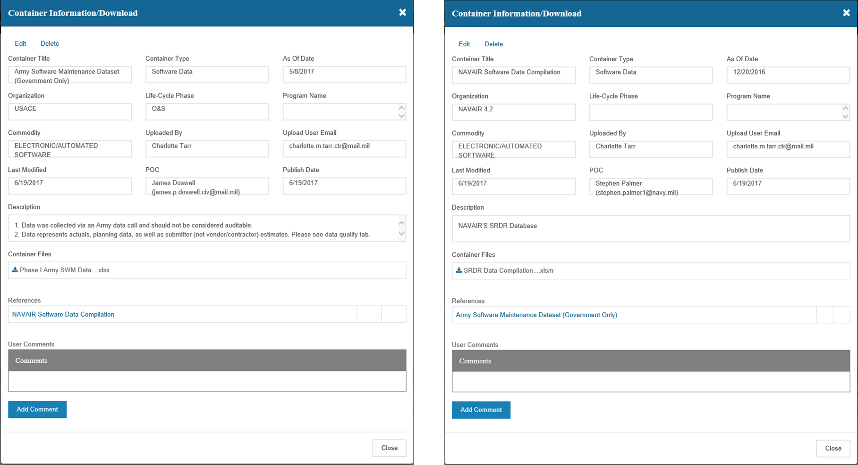
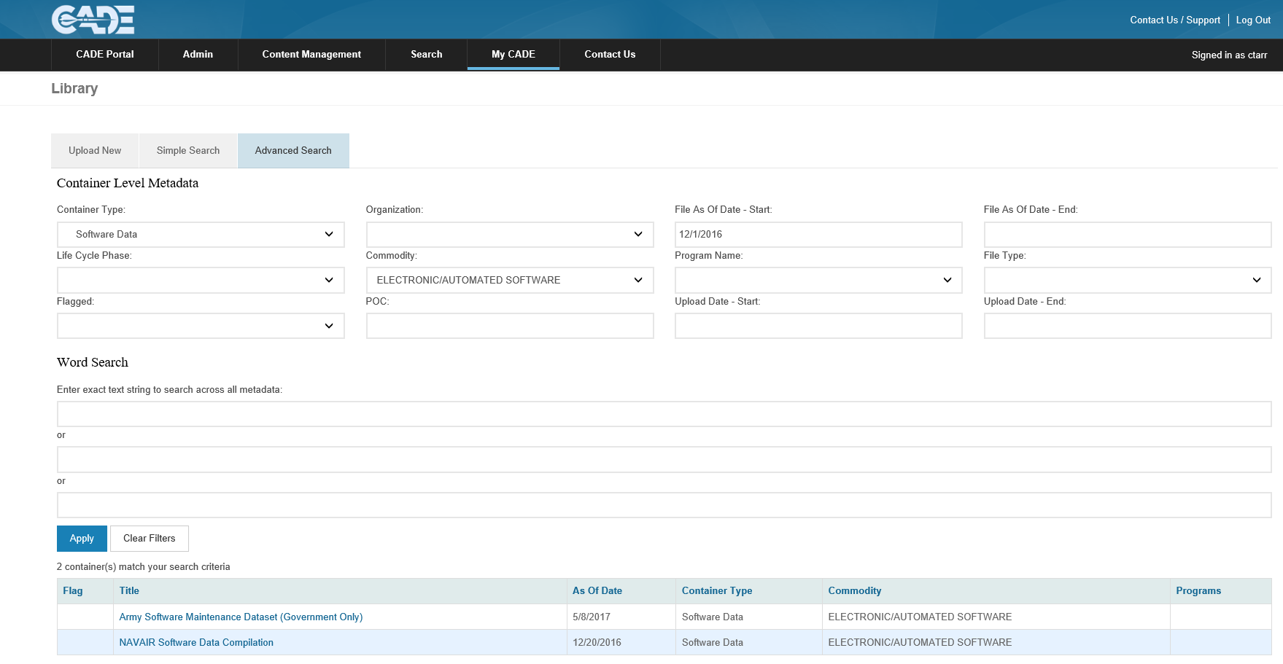

SURF Process Summary & Initial Findings
SRDR Database Location
  Login to CADE and click on “CADE Portal Login”
    http://cade.osd.mil/
  Select “My CADE” from the menu, and click on “CADE Library”
  Use to Advanced Search and filter on “Container Types” under “Software Data”
Question: Where does SRDR data go after SURF Review?
Answer: Once SRDR record has been accepted, Data is entered into SRDR dataset posted to CADE>DACIMs web portal
Question: Who enters the data into the dataset?
Answer: Currently members from NAVAIR 4.2 enter data to SRDR dataset (10+ years of experience). Future data entry is planned to be automated using .XML schemas linked to latest DID formats

Slide 49
SURF Process Summary & Initial Findings
SRDR Data Quality Review
Dataset Posted to OSD CAPE DACIMS Web Portal
Data Segments | Dec-07 | Dec-08 | Oct-10 | Oct -11 | Aug-13 | Apr-14 | Apr-15 | Dec-16
CSCI Records | 688 | 964 | 1473 | 1890 | 2546 | 2624 | 2853 | 3487
Completed program or build | 88 | 191 | 412 | 545 | 790 | 911 | 1074 | 1326
Actuals considered for analysis (e.g., “Good”) | 0 | 119 | 206 | 279 | 400 | 403 | 682 | 829
Paired Initial and Final Records | 0 | 0 | 78 | 142 | 212 | 212 | 212 | 240
  SRDR database is available to Government analysts with access to the CADE portal
  This dataset is the authoritative source for SRDR data (10+ years of uploads)
  Data is not automatically considered “Good” for analysis
  SURF team may recommend DCARC not accept a submission due several data quality concerns outlined in the V&V guide. Examples include:
  Roll-up of lower level data (Did not want to double count effect)
  Significant missing content in hours, productivity, and/or SLOC data missing
  Interim build actual that is not stand alone
  Inconsistencies or oddities in the submit
  Additional reasons discussed in the V&V guide

Slide 50
SURF Process Summary & Initial Findings
SRDR Data Quality Review
2011-2017 Trend Analysis
  Prior to SURF process, only 15% of SRDR data was considered “Good”
  After one+ year of SURF reviews, ~24% of data has been tagged as “Good”
  Army team currently working to review historical data. Once completed, “Good” percentage will likely increase to ~31%
  SURF Team Combined With V&V Guide and DCARC
  Have Significantly Improved Software Data Quality

Slide 51
SURF Process Summary & Initial Findings
SURF Team Status
Key Facts As of June 2017
  Recurring SURF team meetings kicked off on 23 June 2015
    Group includes ~19 Government team members from across the DoD
    Has received very positive feed back from DoD cost estimation community, DCARC analyst(s), and even program office communities since inception
    Completed initial version of SRDR V&V guide March 2015
    Initiated SURF Initial team training using draft V&V guide June 2015
    Completed development of SURF team charter July 2015
    During training period, SURF generated 483 V&V comments provided to DCARC (June 2015 to March 2016)
    Completed official SURF kickoff with DCARC and published V&V guide March 2016
    After training period, formal SURF process generated 889 V&V comments (March 2016 to December 2016)
    Concluding CY16, SURF team generated 1,372 V&V comments from 92 SRDR submissions (1,282 during CY16)
  Current Status
    CY17 represents first full year of official SURF reviews using published V&V guide
    Team recently kicked off effort to update existing V&V questions to align with the latest SRDR DID
    Co-chaired Collaborative Cost Research Group (CCRG) focused on increasing “Good” SRDR records (March 2017)
    Continued process improvement efforts to maintain efficient and effective process
    Working with DCARC to develop SURF User Interface within CADE
  V&V Comments Have Significantly Improved SRDR Data Quality

Slide 52
SURF Process Summary & Initial Findings
SURF Comments by V&V Category
All Reviews (Mar – Dec 2016)

Slide 53
SURF Process Summary & Initial Findings
SURF Team Findings by V&V Category
All Reviews (Mar – Dec 2016)
  V&V comments are generated when SURF members answer a question with “No”
  Common trends for “No” responses:
  Reports not including all types of requirement counts (e.g., new, modified, inherited, deleted, cybersecurity, etc.)
  Reports not including COTS/GOTS “glue code” Software Lines of Code (SLOC) totals
  Reports not including SLOC counts using USC Unified Code Count (UCC) tool
  Reports not including software defect counts
  Reports not including a subset of required metadata (e.g., TD, EMD, Prototype, Service, Milestone, Contract Type, etc.)
  Common trends for “Yes” responses:
  Reports include a subset of metadata (e.g., contractor, contract number, report type, report POC, program name, etc.)
  Reports typically have SLOC counts broken out by new, modified, reuse, auto, and deleted
  Reports typically include primary language type designation
  Reports typically include “Effort” broken out by activity
  Common trends for “N/A” responses:
  Reports typically do not include “Forecast At Completion (FAC)” values
  Reports typically do not include non-SLOC sizing metrics (Function Points, RICE-FW, etc.)
  SURF analyst typically does not have access to corresponding CSDR plan (Working with CADE to develop SURF portal)

Slide 54
SURF Process Summary & Initial Findings
SURF V&V Guide
Process for Update
Currently, SURF members are updating or creating draft question lists to account for new DIDs for Development, Maintenance, and ERP
  Updates to the development question lists include improvements to the list from lessons learned over the previous year
Draft Question lists will then to be sent out to a larger SRDR-focused team members to ensure questions list are reasonable and that they address quality data concerns
  Important to keep question lists to a reasonable size for continued SURF success
V&V guide and question templates to be updated to incorporate new questions as well as other lessons learned
Updated V&V to larger SRDR working group and senior management for final comments/feedback
Send Updated V&V guide to OSD for final PAO approval and posting to CADE

Slide 55
SURF Process Summary & Initial Findings
SURF Summary
SURF is focused on improving data quality and helping support robust Government review process
We would like to thank all of the DoD and Non-DoD individuals who have commented, participated, and provided feedback throughout the past few years
Please feel free to use the contact information below if you would like more information regarding SURF, the SRDR V&V Guide, or checklist
  Marc Russo
  Naval Center for Cost Analysis (NCCA)
  NIPR: Marc.russo1@navy.mil
  Ron Cipressi
  Air Force Cost Analysis Agency
  NIPR: Ronald.p.cipressi.civ@mail.mil
  Nicholas Lanham
  Naval Center for Cost Analysis (NCCA)
  NIPR: Nicholas.lanham@navy.mil
  Dan Strickland
  Missile Defense Agency (MDA)
  NIPR: Daniel.strickland@mda.mil

Slide 56
SURF Process Summary
Backup

Slide 57
SURF Process Summary & Initial Findings
V&V Questions Most Frequently With “No” Response
All Reviews (Mar – Dec 2016)
Question ID | Question from V&V Guide Template | N(No) | N(Yes) | N(N/A) | N(No Resp.)
1.5.1.1 | Does the submission clearly illustrate the number of Inherited, Added, Modified, Deleted, and Deferred requirements for both internal and external categories? | 31 | 0 | 1 | 0
1.5.2.16 | If COTS or GOTS items have been included within the submission, has the submitting organization provided the SLOC total required to integrate the identified COTS/GOTS product (i.e. Glue code)? | 28 | 0 | 4 | 0
1.5.1.2 | Has the submitting organization separated the provided requirements by Security, Safety, and Privacy or Cybersecurity? | 26 | 1 | 5 | 0
1.5.2.4 | Did the submitter us the Aerospace-approved version of the University of Southern California (USC) Center for Systems and Software Engineering (CSSE) Unified Code Count (UCC) tool to count the provided SLOC totals? If not, was the name of the code counting tool used by the submitting organization included within the supporting comments section and/or data dictionary? | 25 | 6 | 1 | 0
1.2.5 | Is the system description been included within the submission? | 24 | 8 | 0 | 0
1.2.2 | Has the Major Defense Acquisition Program (MDAP) or Major Automated Information System (MAIS) designation been listed? | 20 | 2 | 10 | 0
1.3.2.3 | Has the state of development been identified (For example: Prototype, Production Ready, or a mix of the two)? | 19 | 11 | 2 | 0
1.5.4.2 | Has the priority level for each category of software defects been provided? | 18 | 9 | 5 | 0
1.1.9 | Is it clear if the information represents a Technology Demonstration (TD) or Engineering and Manufacturing Development (EMD) phase if the program is in that stage of development? | 17 | 8 | 7 | 0
1.5.2.13 | Has the contractor or submitting organization provided the name of the software products that have been referenced to generate the provided reuse SLOC totals? | 17 | 14 | 1 | 0
1.5.4.1 | Has the submitting organization provided a breakout of the number of software defects Discovered, Removed, and Deferred? | 17 | 10 | 5 | 0
1.7.2 | Has the submitting organization clearly stated if the provided schedule data was reported as estimated, allocated, or actual results? | 16 | 16 | 0 | 0
1.2.16 | Is the specific U.S Military service branch or customer identified (For example: Navy, Air Force, Army, prime contractor, etc.)? | 15 | 14 | 3 | 0
1.3.1.1 | Does the SRDR submission, comments section, or data dictionary include a clear system level functional description and software operational overview? | 15 | 17 | 0 | 0
1.2.6 | Have the program phase and/or milestone been included within the report (for example: Pre-A, A, B, C-LRIP, C-FRP, O&S, etc.)? | 14 | 18 | 0 | 0
1.3.2.1 | Does the SRDR data dictionary include a clear system-level functional description and software operational overview? | 14 | 17 | 1 | 0
1.2.19 | Has the contract Period of Performance (PoP) been identified? | 13 | 19 | 0 | 0
1.2.23 | Does the submission include adequate detail within the comments section to support analysts who may reference the submission sometime in the future (For example: Provide context for analyzing the provided data, such as any unusual circumstances that may have caused the data to diverge from historical norms)? | 13 | 18 | 1 | 0
1.3.3.3 | If an upgrade, does the SW sizing reflect significant reuse or modification SLOC totals when compared to New code? | 13 | 16 | 2 | 1
1.4.5 | Does the peak headcount make sense against the reported schedule and hours? A simple test is to divide the total reported hours by the schedule months and then convert the resulting average monthly hours into an average Full Time Equivalent (FTE) count using the reported hours in a man-month. The peak headcount must be higher than this FTE monthly average. At the same time the peak headcount should not be wildly disproportional to that average either. | 13 | 17 | 1 | 1
1.5.2.10 | Were code adaptation factors reported (percent redesign, recode, reintegration)? Do they appear to be unique for each CSCI, or are they standard rules of thumb? | 13 | 4 | 15 | 0
1.2.17 | Has the specific contract type been identified? For contracts, task orders, or delivery orders with multiple CLINs of varying contract types, the Contract Type reporting should be the one associated with the plurality of cost. | 12 | 20 | 0 | 0
1.2.22 | Has the funding appropriation been identified (for example: Research, Development, Test and Evaluation (RDT&E), Procurement, Operation and Maintenance (O&M), Foreign Military Sales (FMS), etc.)? | 12 | 20 | 0 | 0
1.2.4 | Has the Defense material item category been provided in accordance with MIL-STD-881C guidance (for example: Aircraft, radar, ship, Unmanned Ariel Vehicle (UAV) system)? | 12 | 12 | 8 | 0
1.3.3.5 | Has the development method also been identified (for example: Structured Analysis, Object Oriented, Vienna Development, etc.)? | 12 | 20 | 0 | 0
1.6.2 | Was effort data reported as estimated or actual results? If the submission includes estimated values and actual results, does the report include a clear and documented split between actual results and estimated values? | 12 | 18 | 2 | 0

Slide 58
SURF Process Summary & Initial Findings
V&V Questions Most Frequently With “Yes” Response
All Reviews (Mar – Dec 2016)
Question ID | Question from V&V Guide Template | N(No) | N(Yes) | N(N/A) | N(No Resp.)
1.2.12 | Is the contract number reported? | 0 | 32 | 0 | 0
1.2.20 | Has the report type been identified (for example: Initial, Interim, or Final)? | 0 | 32 | 0 | 0
1.2.7 | Has the contractor or organization that performed the work been identified? | 0 | 32 | 0 | 0
1.2.21 | Is there a single submission Point of Contact (POC) and supporting contact information included within the report? | 3 | 29 | 0 | 0
1.7.1 | Has schedule data been included in the submission? | 3 | 29 | 0 | 0
1.7.4 | Is schedule data broken out by SRDR activity? | 3 | 29 | 0 | 0
1.1.2 | Does the report reference the CSDR Plan? | 4 | 28 | 0 | 0
1.2.1 | Has the program name been identified? | 4 | 28 | 0 | 0
1.5.2.1 | Was the primary programming language reported? | 4 | 28 | 0 | 0
1.5.2.6 | Are the SLOC counts for different types of code (e.g., new, modified, reused, auto-generated, Government-furnished, and deleted) separated or are they mixed together? | 4 | 28 | 0 | 0
1.6.3 | Is the effort data reported in hours? | 4 | 28 | 0 | 0
1.6.4 | Is effort data broken out by activity? | 4 | 28 | 0 | 0
1.6.5 | Was the specific ISO 12207:2008 activities that are covered in the effort data (For example: Requirements analysis, architectural design, detailed design, construction, integration, qualification testing, and support processes) clearly discernable? | 4 | 28 | 0 | 0
1.1.6 | Is there an easily identifiable event associated with the submission (for example: Contract Award, Build 2 Release, Build 1 Complete, Contract Complete, etc.)? | 5 | 27 | 0 | 0
1.6.1 | Was effort data reported for each CSCI or WBS? | 5 | 27 | 0 | 0
1.2.14 | Is the software process maturity and quality reporting definition provided (For example: Capability Maturity Model (CMM), Capability Maturity Model Integration (CMMI), or other alternative rating)? | 4 | 27 | 1 | 0
1.7.3 | Has schedule data been reported in number of months from contract start or as calendar dates? | 3 | 27 | 2 | 0
1.2.13 | Are precedents reported and consistent from submission to submission? | 1 | 27 | 4 | 0
1.3.3.4 | What precedents or prior builds are identified to give credibility to the upgrade designation? | 1 | 27 | 3 | 1
1.3.3.2 | Has the contractor indicated whether the software is an upgrade or new development? If not, why not? | 6 | 26 | 0 | 0
1.4.3 | Does the data dictionary define what the skill level requirements are, and is the contractor adhering to that definition? | 6 | 26 | 0 | 0
1.2.15 | Is the Process Maturity rating reported with an associated date, and has it changed from a prior submission? | 3 | 26 | 3 | 0
1.2.10 | Has the contractor or submitting organization illustrated whether they were the primary or secondary developer? | 7 | 24 | 1 | 0
1.6.6 | Were common WBS elements/labor categories such as System Engineering (SE), Program Management (PM), Configuration Management (CM), or Quality Management (QM) been broken out separately? | 7 | 24 | 1 | 0
1.7.5 | Does the report include unique schedule start and end date values? For example, do multiple records have the same schedule data, e.g., same calendar dates for multiple WBS/CSCIs or builds? | 7 | 24 | 1 | 0
1.2.3 | Is the Prime Mission Product (PMP) name been clearly identified (for example: most current official military designation? | 5 | 24 | 3 | 0

Slide 59
SURF Process Summary & Initial Findings
V&V Questions Most Frequently With “N/A” Response
All Reviews (Mar – Dec 2016)
Question ID | Question from V&V Guide Template | N(No) | N(Yes) | N(N/A) | N(No Resp.)
1.5.3.2 | If function points have been provided has the submitting organization clearly illustrated the function point count type (For example: Enhancement Project, Application, or Development Project)? | 0 | 0 | 32 | 0
1.5.3.3 | Has the submitting organization provided the number of Data Functions and Transactional Functions (For example: Internal Logic Files, External Interface File, External Inquiries, External Inputs, and External Outputs)? | 0 | 0 | 32 | 0
1.5.3.4 | Has the submitting organization included the Value Adjustment Factor? | 0 | 0 | 32 | 0
1.5.3.5 | If the submitting organization has provided sizing metrics using the Reports, Interfaces, Conversions, Extensions, Forms, and Workflows (RICE-FW) convention, has the complexity of each RICE-FW category been provided? | 0 | 0 | 32 | 0
1.8.1 | FACH: Has a description been provided that describes which ISO 12207:2008 elements have been included within the provided total? | 1 | 0 | 31 | 0
1.8.2 | FACH: Do sub-element FAC values sum to the parent FAC total value? | 1 | 0 | 31 | 0
1.8.3 | If the report is a final report, does the provided ATD total match the provided FAC total? | 1 | 0 | 31 | 0
1.1.1 | Is the submission compliant with the CSDR Plan, i.e., a comparison of the submission to the plan requirement? | 1 | 1 | 30 | 0
1.5.3.1 | Were SLOC counts reported, or were other counting or sizing metrics used (e.g. function points, use cases, rung logic ladders, etc.)? If so, has the submitting organization obtained the appropriate authorization to report non-SLOC based sizing within the corresponding CSDR plan? | 0 | 3 | 29 | 0
1.6.17 | If subcontractor hours have not been provided, did the reporting organization provide subcontractor dollars? | 2 | 1 | 29 | 0
1.5.2.17 | If COTS or GOTS integration or glue code has been included within the submission, does the total seem realistic when compared to the total SLOC included in the CSCI or WBS element (For example: COTS integration code equals 500 KSLOC and the total SLOC for the specific CSCI or WBS element equals 150 KSLOC)? note: this scenario sometime occurs when the submitting organization counts the total SLOC of the specified COTS or GOTS product vice the integration or glue code required to integrate the product. | 3 | 0 | 28 | 1
1.6.9 | Do the children or lower-level WBS/CSCI elements add up to the parent? If not, is there effort that is only captured at a higher-level WBS/CSCI level that should be allocated to the lower-level WBS/CSCI elements? | 5 | 3 | 24 | 0
1.2.18 | Has the total contract price been identified? | 9 | 0 | 23 | 0
1.5.1.3 | Do the number of requirements trace from the parent to the children in the WBS? If not, this could imply that some portion of the software effort is only captured at higher-level WBS/ CSCI elements and should be cross checked. | 3 | 4 | 23 | 2
1.5.2.9 | For a Final report does the size look realistic? For example: is all of the code rounded to the nearest 1000 lines, or does the dictionary indicate that they had difficulty counting code that may have come from a subcontractor? | 1 | 9 | 22 | 0
1.1.7 | If there are prior submissions, is this submission an update to a prior submission or a new event? If the submission is an update to an existing submission, does the latest submission clearly describe what report the prior submission is linked to? | 2 | 8 | 21 | 1
1.2.11 | If effort was outsourced, has the outsourced organization been provided? | 4 | 7 | 21 | 0
1.6.7 | Is there an explanation of missing activities included within the supporting SRDR data dictionary? | 7 | 4 | 21 | 0
1.1.8 | If a prior submissions exists, is the information that has changed readily identifiable and a reason for the change provided (either in the data dictionary or comments section)? | 5 | 6 | 20 | 1
1.4.4 | Does the skill mix make sense relative to the complexity of the code (unusual amount of very low or very high skill mix, for example)? | 0 | 12 | 20 | 0
1.5.4.3 | If the report is an interim or final submission, has the number of Discovered, Removed, and Deferred defects changed from the previous submission? If significant changes have occurred, does the supporting comments section and/or data dictionary provide details regarding what drove the significant change in product quality metrics? | 10 | 2 | 20 | 0
1.6.12 | Does the submission include unique values for each of the lower-level CSCI or WBS elements? For example, do multiple related records have the same effort data (i.e. activity effort is repeated or total effort is repeated)? | 6 | 6 | 20 | 0
1.4.2 | If there was a prior submission, has the skill mix changed dramatically and, if so, is there an explanation why? Conversely, did it remain unchanged? If so, why? | 8 | 4 | 19 | 1
1.5.2.14 | When subcontractor code is present, is it segregated from the prime contractor effort, and does it meet the same criteria for quality as the prime’s code count? | 6 | 7 | 19 | 0

